Slide 1
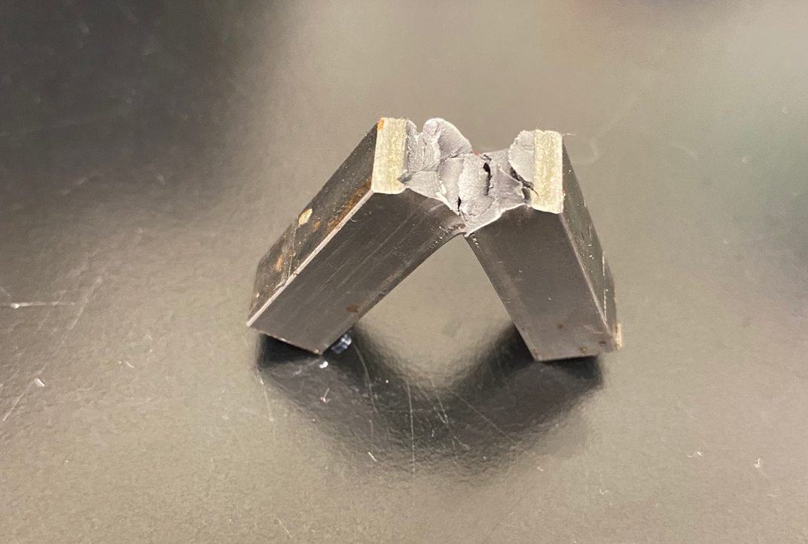
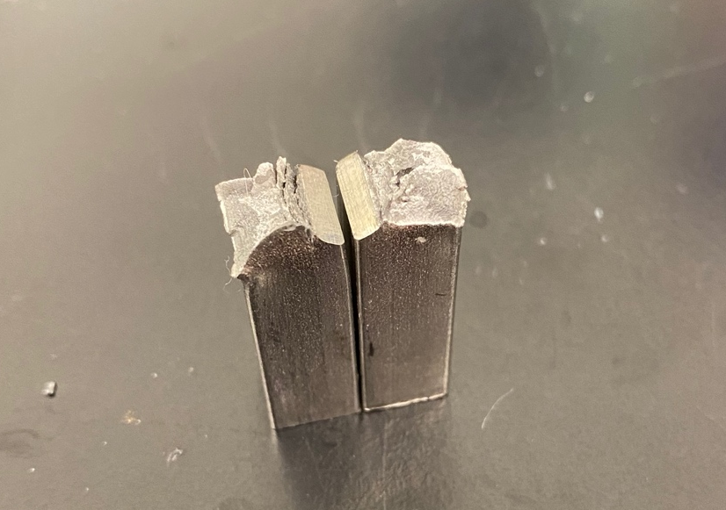
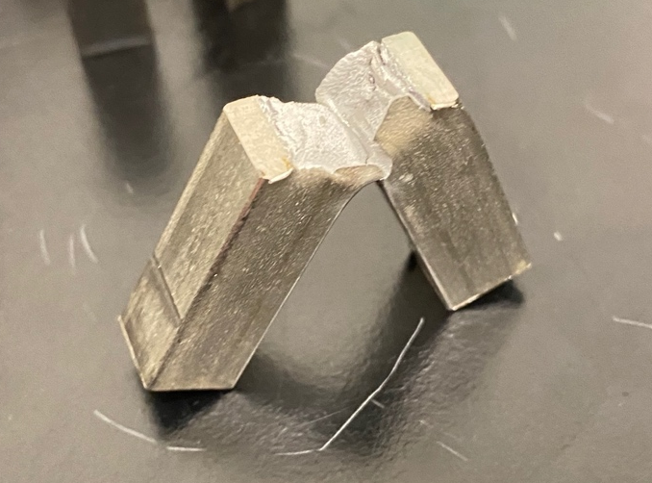
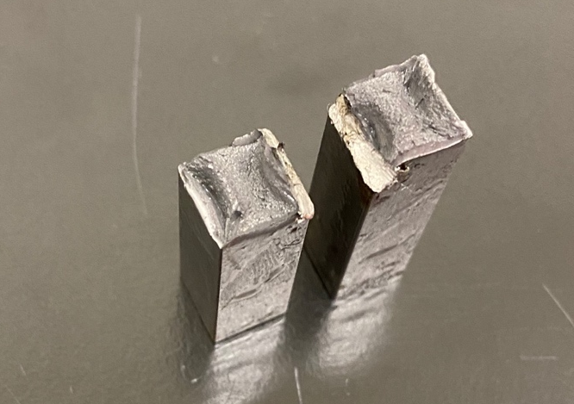
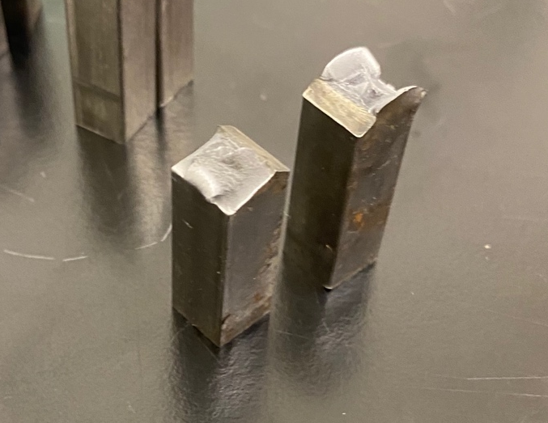
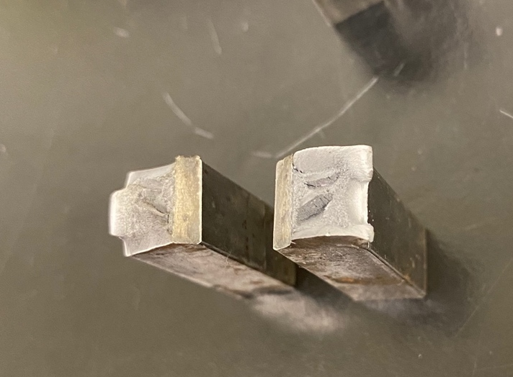
304 Stainless Steel in Ice Water
1018 Steel in Ice Water
304 Stainless Steel in Dry Ice
1018 Steel in Dry Ice
304 Stainless Steel in Boiling Water
1018 Steel in Boiling Water

